Slide 1
PRODUCTION SYSTEM

Slide 2
PRODUCTION SYSTEM IN AI
Type of computer program that provides solution to an AI problem based on a set of rules
C → A
Condition Action
Facilitate describing and performing the search process

Slide 3
Elements of a Production System
Global Database (Working Memory) – Primary Database that contains all the information necessary to complete the task.
Temporary – Information relevant to current situation only
Permanent – Information about fixed actions
Knowledge base (Set of Production Rules + Factual data) – A set of rules that operate on the global database
If a condition is met by the global database, then production rule is applied successfully
Control System – Decides which production rule should be applied, stops computation when a termination condition is met.
Rule Applier

Slide 4
PRODUCTION RULES
Starting from the initial state, a set of rules is used to move some one state to another – Production rules
State-space representation forms the basis of most of the AI methods

Slide 5
Characteristics (PS)
Monotonic PS:
The addition of new rules to the knowledge base does not invalidate or contradict existing rules.
Once a rule is true or applicable for a given set of conditions, it remains true for those conditions, regardless of any additional rules that might be added later.
Application of one rule never prevents the application of another rule (Rules are independent)

Slide 6
Characteristics (PS)
2. Non monotonic PS:
Such systems allows the revision of conclusions and beliefs based on new information or changes in the knowledge base.
Unlike monotonic production systems, nonmonotonic systems can retract or modify previously derived conclusions when faced with new evidence
These are useful for solving ignorable problems.
Not necessary to keep track of the changes made in the search process.

Slide 7
Characteristics (PS)
3. Partially commutative PS:
Here, the order of operation is important.
If a given set of rules is employed to convert a start state A into a different state B, then the same results can be attained using any permutation of these production rules.
4. Commutative PS:
1. Both monotonic and partially commutative
2. Production system where the order of rule application does not affect the final outcome or result.
3. In other words, commutative production systems are those where the sequence in which the rules are fired or executed does not change the end result.

Slide 8
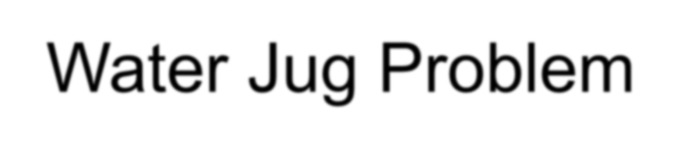
You are given two jugs, a 4-gallon and a 3-gallon, a pump which has unlimited water which you can use to fill the jug, and the ground on which water may be poured. Neither jug has any measuring markings on it.
How can you get exactly 2 gallons of water in the 4-gallon jug?

Slide 9
State Space Search: Water Jug Problem
State: (x, y)
x = 0, 1, 2, 3, or 4
Start state: (0, 0)
y = 0, 1, 2, 3
Goal state: (2, n) for any n such that n<=3

Slide 10
State Representation and Initial State
Represent a state of the problem as a tuple
(x, y) where x represents the amount of water in the 4-gallon jug and
y represents the amount of water in the 3- gallon jug
0 ≤ x ≤ 4, and 0 ≤ y ≤ 3
Our initial state: (0,0)
Goal state = (2,y) where 0 ≤ y ≤ 3

Slide 11
Operators
1. Fill 4-gal jug (x,y) → (4,y) x < 4
2. Fill 3-gal jug (x,y) → (x,3) y < 3
3. Empty 4-gal jug on ground (x,y) → (0,y) x > 0
4. Empty 3-gal jug on ground (x,y) → (x,0) y > 0

Slide 12
(Contd..)
5. Pour water from 3-gal jug (x,y) → (4, y - (4 - x))
to fill 4-gal jug 0 < x+y ≥ 4 and y > 0
6. Pour water from 4-gal jug (x,y) → (x - (3-y), 3)
to fill 3-gal-jug 0 < x+y ≥ 3 and x > 0
7. Pour all of water from 3-gal jug (x,y) → (x+y, 0)
into 4-gal jug 0 < x+y ≤ 4 and y ≥ 0
8. Pour all of water from 4-gal jug (x,y) → (0, x+y)
into 3-gal jug 0 < x+y ≤ 3 and x ≥ 0

Slide 13
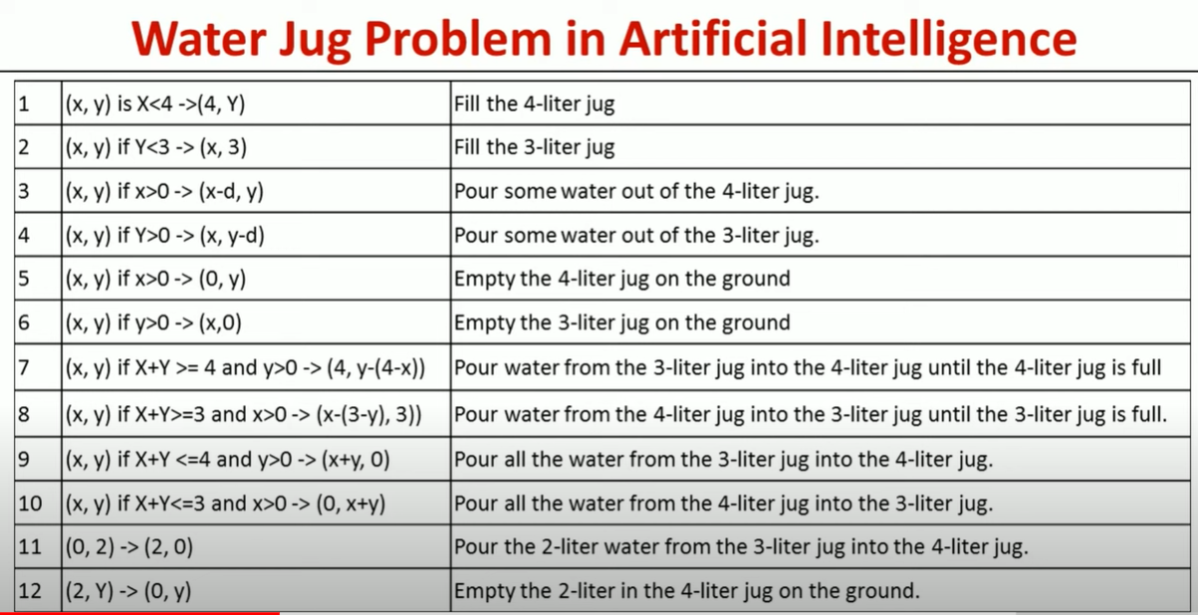
Operators

Slide 14
S.No. 4 gallon jug 3 gallon jug Rule
1. 0 gallon 0 gallon Initial state
2. 0 gallon 3 gallon Rule no.2
3. 3 gallons 0 gallon Rule no. 9
4. 3 gallons 3 gallons Rule no. 2
5. 4 gallons 2 gallons Rule no. 7
6. 0 gallon 2 gallons Rule no. 5
7. 2 gallons 0 gallon Rule no. 9
On reaching the 7th attempt, we reach a state which is our goal state.

Slide 15
One solution to the water jug problem
Gallons in the 4-gallon jug | Gallons in the 3-gallon jug | Rule Applied
0 | 0 | 2
0 | 3 | 9
3 | 0 | 2
3 | 3 | 7
4 | 2 | 5 or 12
0 | 2 | 9 or 11
2 | 0

